Slide 1
Interface Computing:
Computationally Optimizing the Design of Interactive Search Engine Interfaces
ChengXiang (“Cheng”) Zhai
Department of Computer Science
University of Illinois at Urbana-Champaign

Slide 2

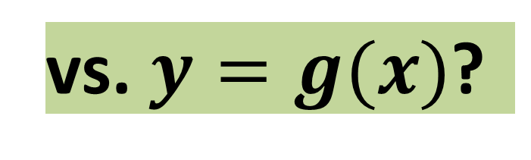
All computing applications must have a user interface
vs. $y=g(x)$?
$$y=f(x)$$
Where/How can I input x?
Where/How can I invoke function f?
Where/How can I obtain y?

Slide 3
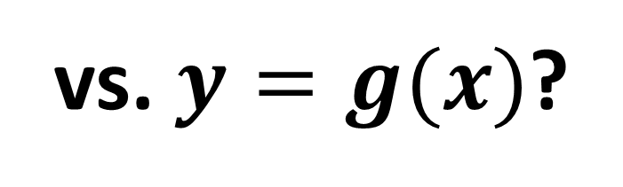
User interface varies and matters a lot!
Undo?
Visualization ….
vs. $y=g(x)$?
$$y=f(x)$$
Help me chooe?
Preview of f vs. g?
Where/How can I input x?
0.1 Second vs. 3 Seconds vs. 3 minutes?
Where/How can I invoke function f?
Type in vs. Select from menu?
Where/How can I obtain y?
Read it on screen vs. Retrieve it on disk vs. both?

Slide 4


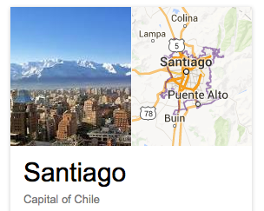
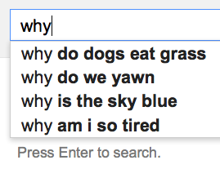
Even more complicated variations of interface
(search engine, and all intelligent interactive systems)
… or a combination of some of these?
How to allocate screen space among different blocks?

Slide 5
How can we optimize interface design?
Undo?
Visualization ….
vs. $y=g(x)$?
$$y=f(x)$$
Help me chooe?
Preview of f vs. g?
Where/How can I input x?
0.1 Second vs. 3 Seconds vs. 3 minutes?
Where/How can I invoke function f?
Type in vs. Select from menu?
Where/How can I obtain y?
Read it on screen vs. Retrieve it on disk vs. both?

Slide 6
How can we optimize interface design?
Research in Human-Computer Interaction (HCI) offers many useful guidelines, but
  many guidelines are vague (e.g., user wants “control”, likes “simple”, …)
  application of the guidelines in practice is an art!
As a result,
  current interfaces are mostly manually designed by human experts
  Interfaces are optimized for envisioned “typical” users
  Interfaces are “static,” unable to dynamically adapt to a specific user’s behavior

Slide 7
How can we optimize interface design?
Research in Human-Computer Interaction (HCI) offers many useful guidelines, but
  many guidelines are vague (e.g., user wants “control”, likes “simple”, …)
  application of the guidelines in practice is an art!
As a result,
  current interfaces are mostly manually designed by human experts
  Interfaces are optimized for envisioned “typical” users
  Interfaces are static, unable to dynamically adapt to a specific user’s behavior
automatically designed by computers?
all users?
dynamically adapt to every user after every user action?

Slide 8
Interface Computing: A New Direction
Goal:
  design algorithms to automatically generate an optimal interface
  make interface design a science rather than an art
  optimize interfaces for all users all the time!
Challenges
  How to mathematically define an “optimal interface”?
  How to ensure optimality for every user?
  How to adapt to every user action?
Feasibility of computing a user interface?

Slide 9
Main Points of this Talk
Goal:
  design algorithms to automatically generate an optimal interface
  make interface design a science rather than an art
  optimize interfaces for all users all the time!
Challenges
  How to mathematically define an “optimal interface”?
  How to ensure optimality for every user?
  How to adapt to every user action?
Interface Card Model
User Modeling
Sequential Decision Making
Feasibility of computing a user interface?
Yes!

Slide 10
Rest of the talk
Interface Card Model (ICM)
ICM for Optimization of Interactive Interface of Search Engines
Experiments
Conclusions and Future Directions
Yinan Zhang, ChengXiang Zhai, Information Retrieval as Card Playing: A Formal Model for
Optimizing Interactive Retrieval Interface, Proceedings of ACM SIGIR 2015.
Yinan Zhang, ChengXiang Zhai, A Sequential Decision Formulation of the Interface Card Model
for Interactive IR, Proceedings of ACM SIGIR 2015.

Slide 11
Key Idea of ICM:
Human-Computer Interaction = Cooperative Game-Playing
Players: Player 1= computer system; Player 2= user
Rules of game:
  Player take turns to make “moves”
    User move = user action
    System move = show an “interface card”
  For each action taken by user, system responds by showing an interface card
  For each interface card shown, user responds by taking an action
  First move = User starts an application software with a particular configuration
  Last move = User stops using the system (with task either finished or not)
Objective: help the user complete the task with minimum effort & minimum operating cost for system

Slide 12
Example of cooperative game-playing: search engine
(Finish a user task
with minimum effort)
(Help user finish a task
with minimum effort, minimum system cost)
User
System
A₁ : Enter a query
Which information items to present?
How to present them?
Which items
to view?
R₁: results (i=1, 2, 3, …)
Which aspects/parts of the item
to show? How?
Interface Card
A₂ : View item
No
View more?
R₂: Item summary/preview
A₃ : Scroll down or click on
“Back”/”Next” button

Slide 13
Optimal User Interface = Optimal “Card Playing”
In each interaction lap
… facing an (evolving) interaction context
… the system tries to play a card
… that optimizes the user’s expected surplus
… based on the user’s action model and reward / cost estimates
… given all the constraints on card

Slide 14
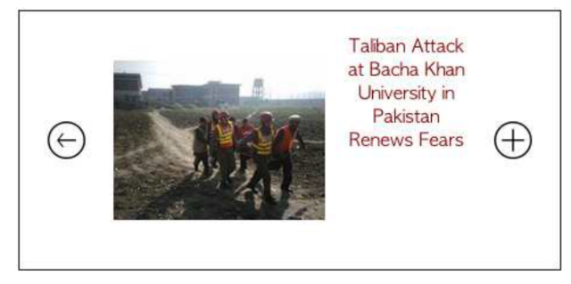
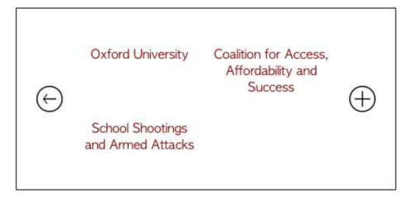
Example of interface optimization
Context c^{t}
After a user clicks on “Colleges & Universities”,
which interface card q^{t} to show?
If user action a^{t+1}= view content
If showing card q^{t}
surplus for a^{t+1} :
u(a^{t+1} |q^{t},c^{t})= gain - cost
A different card
If user action a^{t+1}= “see more”?
If user action a^{t+1}= “navigate”?

Slide 15


Expected surplus of an interface card: E(u^{t}|q^{t},c^{t})
E(u^{t} |q^{t} = ,c^{t} )
=p( a^{t} =“view content” |c^{t} ,q^{t}) × u( | c^{t} ,q^{t})
u( | c^{t} ,q^{t})= Gain ( ) – Cost(Viewing)
Gain ( )=Relevance( )
+ p( a^{t} =“see more”|c^{t} ,q^{t})×u( | c^{t} ,q^{t}) + …
Depends on the next interface card q^{t+1}

Slide 16

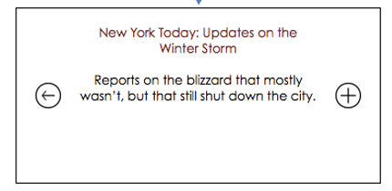
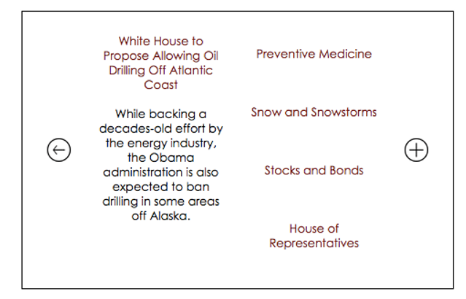


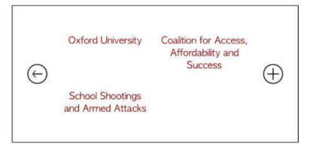
Expected surplus of an interface card: E(u^{t}|q^{t},c^{t})
E(u^{t} |q^{t} = ,c^{t} )
=p( a^{t} =“left-top tag” |c^{t} ,q^{t}) × u( | c^{t} ,q^{t})
+ p( a^{t} =“right-top tag”|c^{t} ,q^{t})×u( | c^{t} ,q^{t})
+ p( a^{t} =“left-bottom tag”|c^{t} ,q^{t})×u( | c^{t} ,q^{t})
+ …

Slide 17
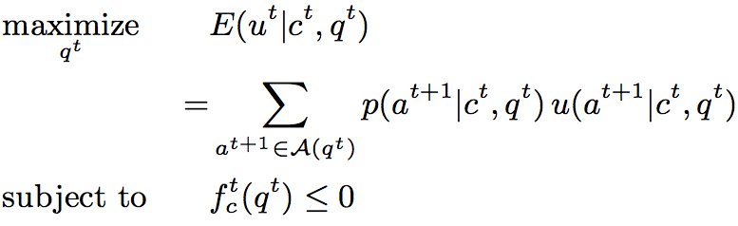
ICM: Formal Definition

Slide 18
Interface card

Slide 19
Context

Slide 20
Action set

Slide 21
Action model

Slide 22

Reward Cost
Action surplus

Slide 23
Expected surplus

Slide 24
Constraint(s)

Slide 25
Refinements/Instantiations of ICM
ICM (sequential
decision form)
Stop
Action
ICM
ICM-US
MDP
Explicit US
User
State
ICM-US
POMDP
Implicit US

Slide 26
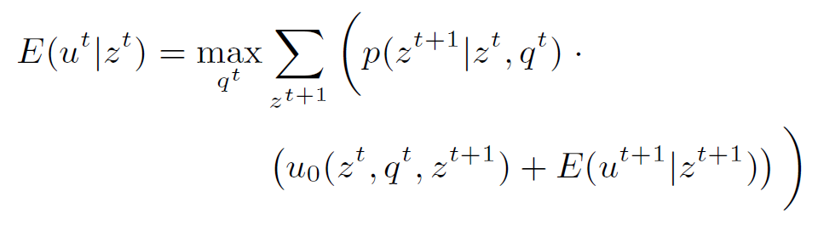
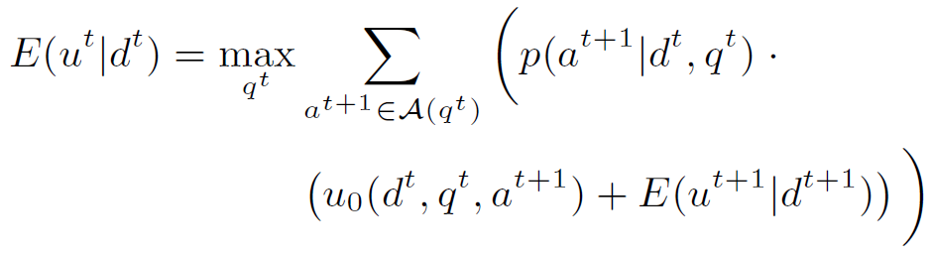
ICM-US model
MDP form:
POMDP form:

Slide 27




Stop action model
An ordinary user action
  Stopping rate:
  Zero expected future surplus:
Constant stopping rate (CSR)

Slide 28
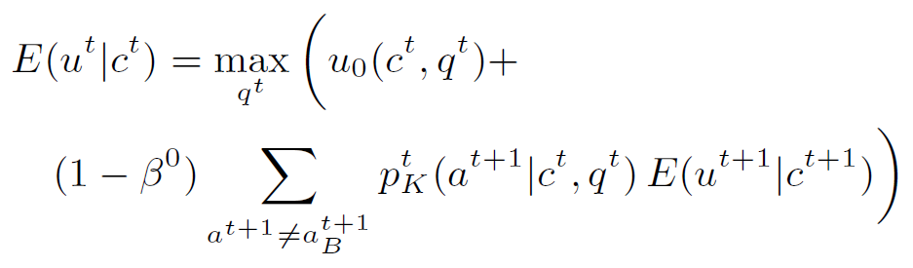
CSR => diminishing reward

Slide 29
Next Topic
Interface Card Model (ICM)
ICM for Optimization of Interactive Interface of Search Engines
Experiments
Conclusions and Future Directions

Slide 30
How to optimize interface design for a search engine?
… or a combination of some of these?
How to allocate screen space among different blocks?

Slide 31
ICM for Interactive Retrieval Optimization:
Plain Card
ICM (sequential
decision form)
Stop
Action
ICM
ICM-US
MDP
Explicit US
Plain card
User
State
ICM-US
POMDP
Implicit US

Slide 32
Plain Card (IIR-PRP)

Slide 33
“Backward compatibility”
If we assume sequential interaction reduces to sequential browsing …
q¹
q²
q³
q⁴

Slide 34
Instantiation
Card: a choice in a ranked list
Constraint: none
Action: accept / skip a choice
Context: constant until an accept
Reward (for skip): expected surplus in next lap
Cost: decision cost

Slide 35

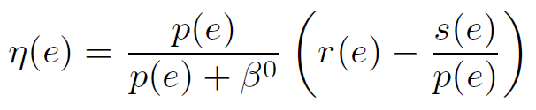
Plain card
Plain user state
Assume CSR
Ranking principle
Further promote
more relevant items
IIR-PRP

Slide 36
ICM for Interactive Retrieval Optimization:
Navigational Card
ICM (sequential
decision form)
Stop
Action
ICM
ICM-US
MDP
Explicit US
Plain card
User
State
ICM-US
POMDP
Navigational
card
Implicit US

Slide 37
Navigational Card

Slide 38
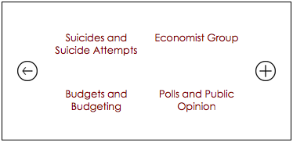
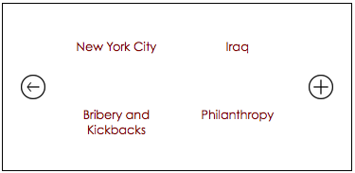
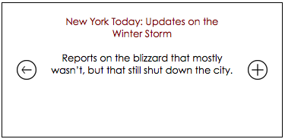
What IIR-PRP cannot do …
If sequential interaction does not reduce to sequential browsing (e.g. on mobile screen) …

Slide 39
Instantiation
Card: a set of item/tag blocks
Constraint: total area does not exceed the card
Action: select block based on item-tag relations
Context: updated based on user actions
Reward: information gain of user interest estimate
Cost: constant for each lap

Slide 40
Analytical Study
Goal
  Derive the optimal mathematical conditions for the blocks on the card
Assumptions
  Uniform initial preference
  Uniform and perfect action model
  Only focus on tags (items would be more trivial)
  “Complete” tag set

Slide 41



One tag per card
What is the optimal number of items the picked tag should cover?
Balanced partition

Slide 42

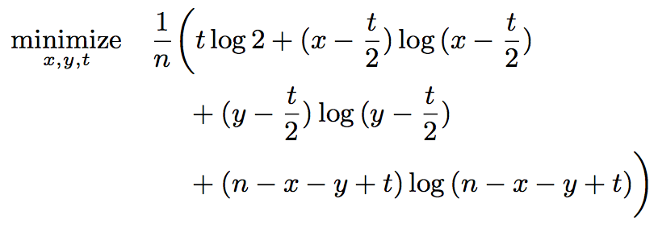


Two tags per card
How many items should each of the two picked tags cover?
How many items should the two tags’ coverage overlap?
Balanced partition
Minimal overlap

Slide 43
Next Topic
Interface Card Model (ICM)
ICM for Optimization of Interactive Interface of Search Engines
Experiments
Conclusions and Future Directions

Slide 44
User study experiments
Setting
  Prototype interfaces for New York Times
  Articles as items and keywords as tags
  Two sizes: a medium sized one and a small one
Comparison
  # Interaction rounds to reach item of interest
  We automatically optimize the interface layout
  Compare with pre-designed static interfaces

Slide 45
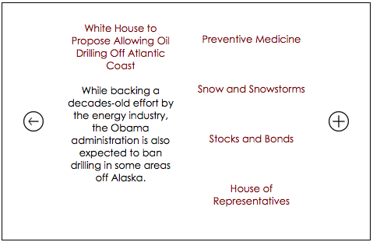
Medium sized screen

Slide 46

Smaller screen

Slide 47
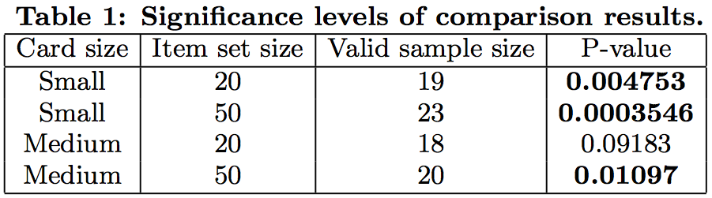
# Interaction round comparison
http://timan102.cs.illinois.edu/yzhng103/fomalhaut/s-times-navigation.php
http://timan102.cs.illinois.edu/yzhng103/fomalhaut/m-times-navigation.php

Slide 48
Adaptation to user stopping tendency
User stop action: zero expected future surplus
User interest state: the user’s interested item
  Hidden; does not change across laps
Variables to examine in experiments
  Screen size: S = Small; M = Medium
  User patience level: P = Patient; I = Impatient
Simulation experiments
User study experiments

Slide 49
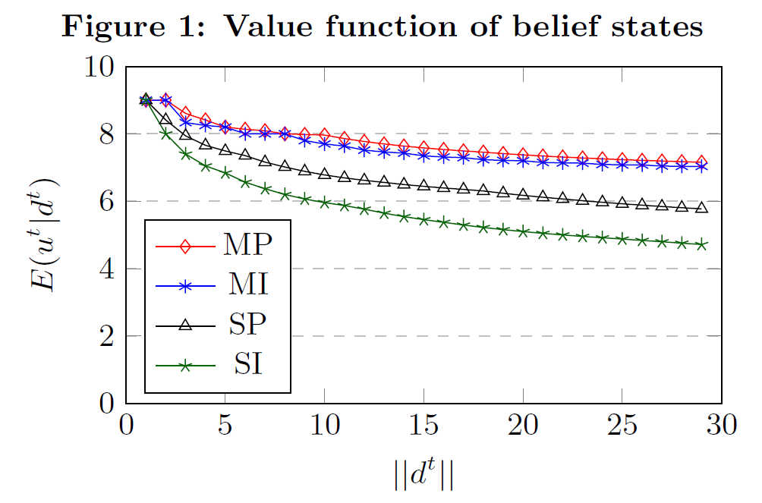
Simulation experiments

Slide 50
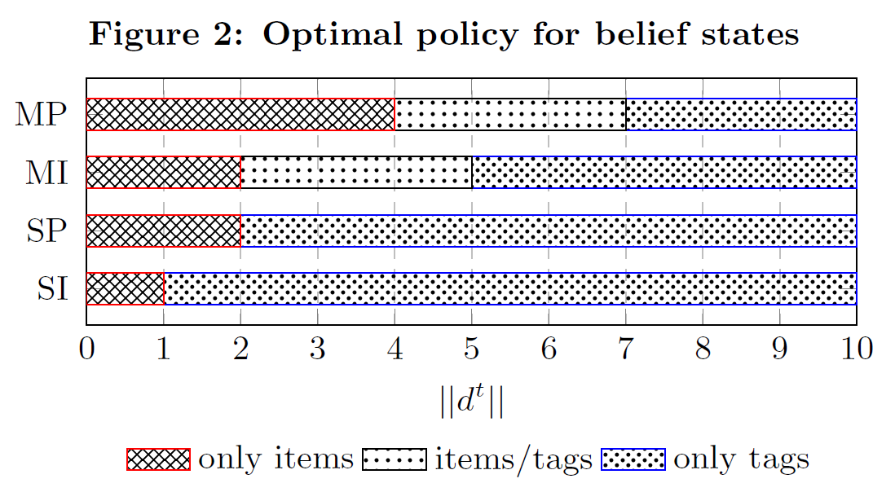
Simulation experiments

Slide 51
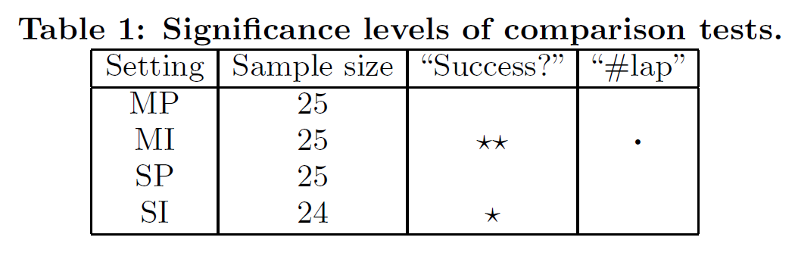


Additional user study experiments

Slide 52
Next Topic
Interface Card Model (ICM)
ICM for Optimization of Interactive Interface of Search Engines
Experiments
Conclusions and Future Directions

Slide 53
Conclusions
Interface Optimization is important, especially for interactive intelligent information systems
Interface Computing is feasible
  Frame human-computer interaction as cooperative game playing
  Formally model user actions and surplus
  Choose an optimal interface using Interface Card Model to maximize expected gain and minimize expected cost
Specific algorithms for computing adaptive navigation interface for search engines
  Adaptive to confidence about user’s interest, screen size, user patience)

Slide 54
High-Level Challenges in Interface Computing
How should we design the “co-operative game” for an application?
  How to design “moves” for the user and the system? (there are usually many more moves possible!)
  How to design the objective of the game?
How to formally define the optimization problem and compute the optimal interface?
  How to formally model user actions?
  How to quantify surplus and cost of user actions?
  How to directly parameterize E(u^{t}|c^{t},q^{t}) based on features? [Wang et al. 2016]
How to compute optimal interfaces quickly?
How to evaluate a compute-generated interface? A/B test?
Yue Wang, Dawei Yin, Luo Jie, Pengyuan Wang, Makoto Yamada, Yi Chang, and Qiaozhu Mei. 2016. Beyond Ranking: Optimizing Whole-Page Presentation. In Proceedings of WSDM 2016.

Slide 55
ICM: Future Directions
1. How to define space of interface cards?
6. How to solve the optimization problem efficiently (subject to resource constraint)?
2. How to define space of user actions?
4. How to model action cost & surplus?
3. How to model user actions?
5. How to model and define constraints?
7. How to define E(u^{t}|c^{t},q^{t}) directly based on features?

Slide 56
Research in Interface Computing is Highly Interdisciplinary
1. How to define space of interface cards?
6. How to solve the optimization problem efficiently (subject to resource constraint)?
Optimization + High-Performance Computing
Applications (IR)
+ Human-Computer
Interaction
2. How to define space of user actions?
4. How to model action cost & surplus?
3. How to model user actions?
5. How to model and define constraints?
Human-Computer Interaction + Machine Learning
7. How to define E(u^{t}|c^{t},q^{t}) directly based on features?

Slide 57
Thank You!
Questions/Comments?
Looking forward to
opportunities to collaborate!

